Slide 1
Team 5: Online Blogging
Members:
Albin GEORGE
Nagaratna GUDLANOOR
PALLERLA ShabARESH
Pamidi SHIREESHA
Sakshi RAI
Sheirsh Saxena
Subhash CHANDER VERMA
Sujeet kumar Ajeet

Slide 2
TECHNOLOGIES USED
Front End: HTML, CSS, JavaScript, BootStrap
Back End: JSP, Servlets
Connectivity: JDBC
Software Used: Eclipse

Slide 3
Problem Statement
To design a Blogging site with functionalities such as login, signup, showcase Blogs, along with admin and user privileges .

Slide 4
Flowchart/Data Flow diagram

Slide 5
HomePage
Login
User/Admin
Login/Register/Forgot Password
Forgot Password
AdminView
UserView
Registration
Password Reset Successful
Registration Successful

Slide 6
UserView
Latest Blogs
Top Blogs
Category-wise Blogs
Create Blog
Edit blog
Profile
Log Out
Blogs,Likes And Comments
Insert or Edit Contents,Images,Title,Adjust Size
Add or Change Profile Pictures and Profile Details
HomePage

Slide 7
Admin View
Register User
View All Users
View Specific User
Edit Category
Remove User
Profile
Log Out
Add or Change Profile Pictures and Profile Details
Add Category
Add Sub Category
Delete Category
Delete Sub Category
Add Image
Home Page

Slide 8
Admin View
View Blogs
Mail Box
Edit User Role
View Comments
Rejected Blogs
Pending For Approval
Category-wise Blogs
User Specific Blogs
View Date Specific Blogs
User Specific Comments
Blog Specific Comments
Pending Blogs
Pending Comments

Slide 9
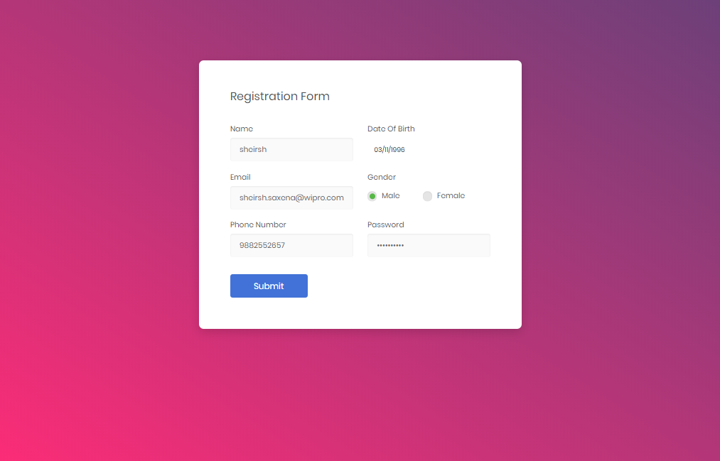
Registration Form
The user can register here and can access the Online Blogging System

Slide 10
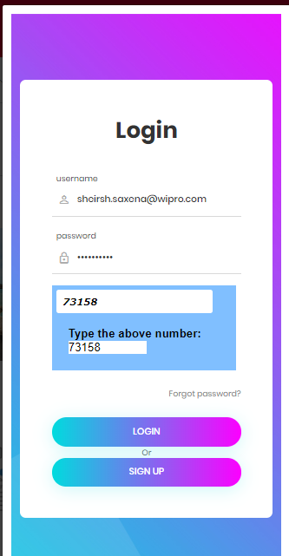
Login Page
The admin and user can access the home page of the Online Blogging System, with the username and password provided and logs into the website.

Slide 11
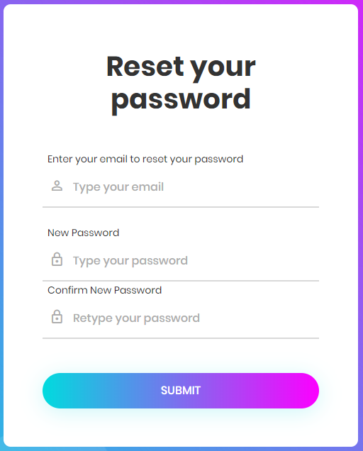
Forgot Password
This page is visible for all the users . This helps the users to change the current password to a new one.

Slide 12
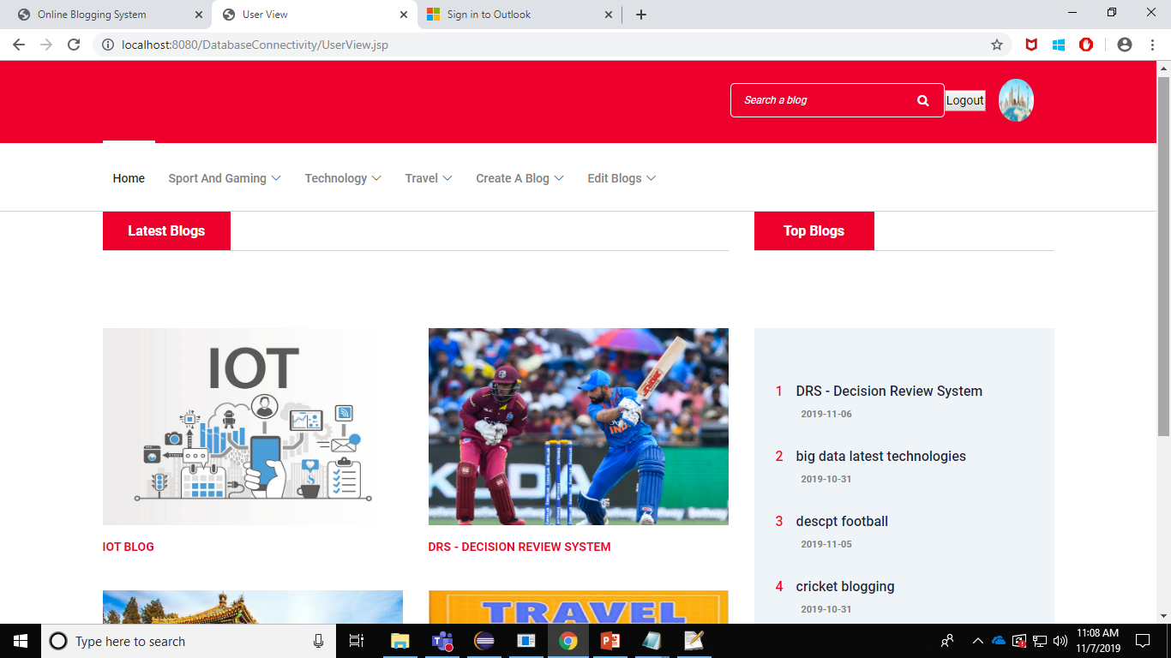
User View
​Once the user is logged in, he will be able to view top blogs, latest blogs, category-wise blogs and view his profile. He can search a blog and update his profile details, create a blog and edit his blogs. After the work is done, he can logout from the website.​
​

Slide 13
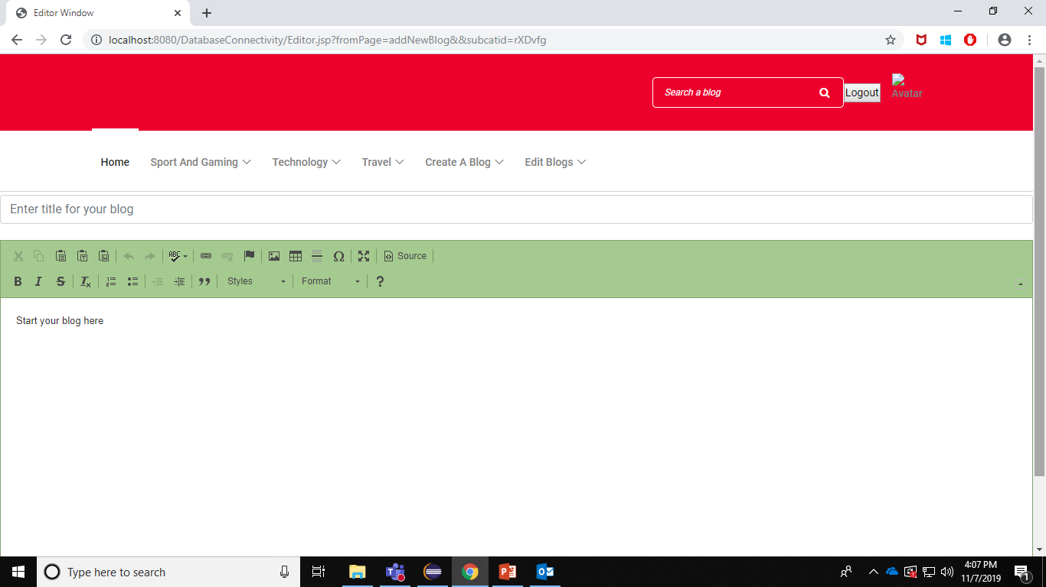
User-Creating a Blog
This is the editor page. Here the user can create a blog for particular category by adding text, images, tables and give title of the blog

Slide 14
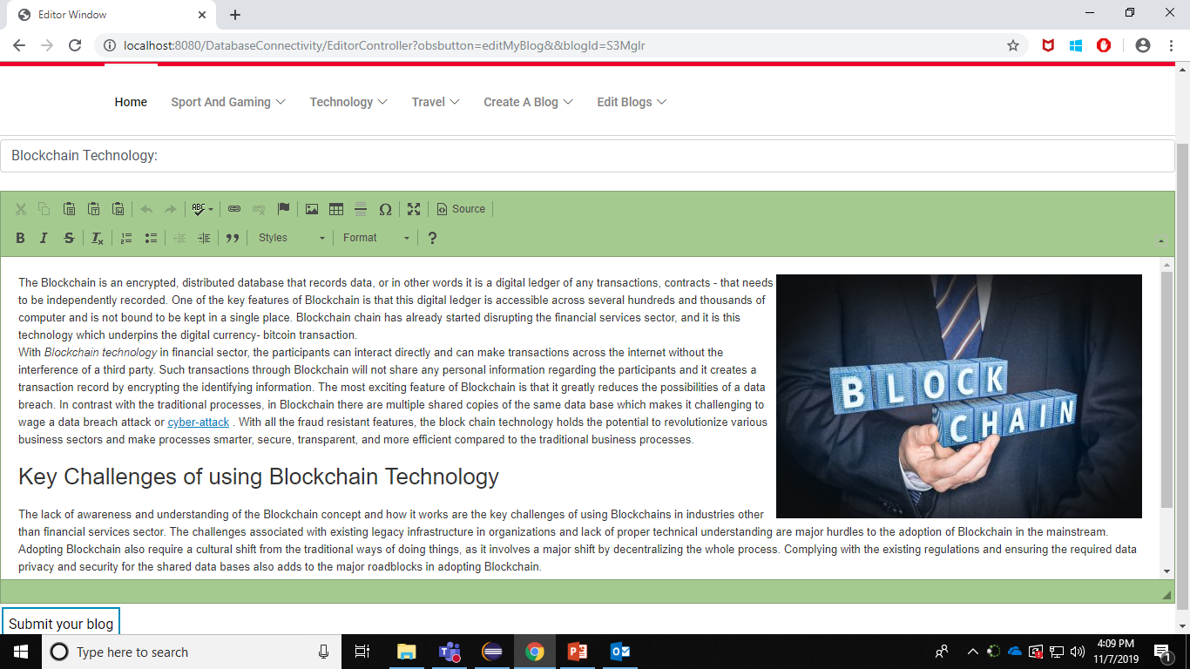
User-Editing a Blog
Here the user can edit his own existing blog for particular category by adding text, images, tables and give title of the blog

Slide 15
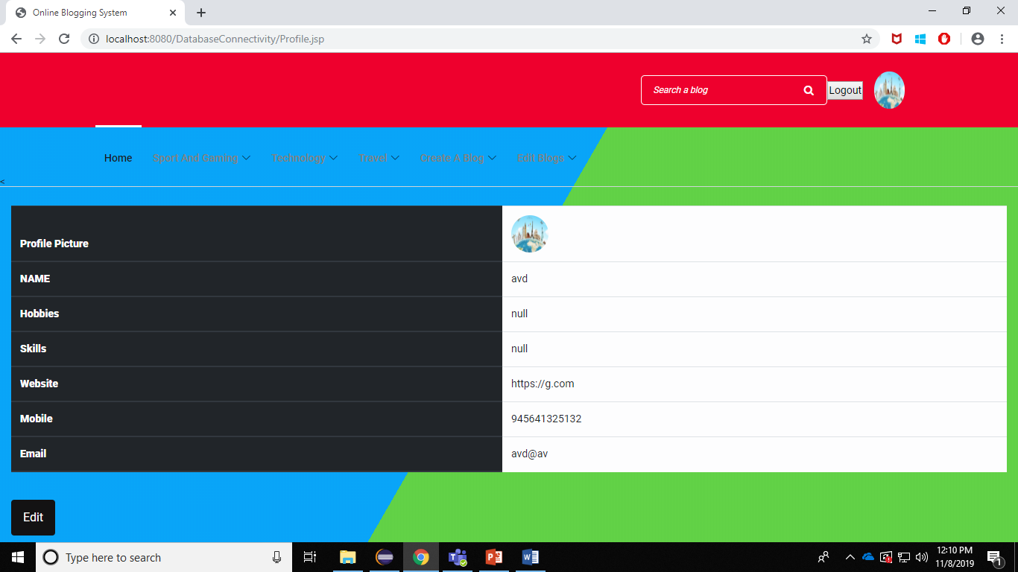
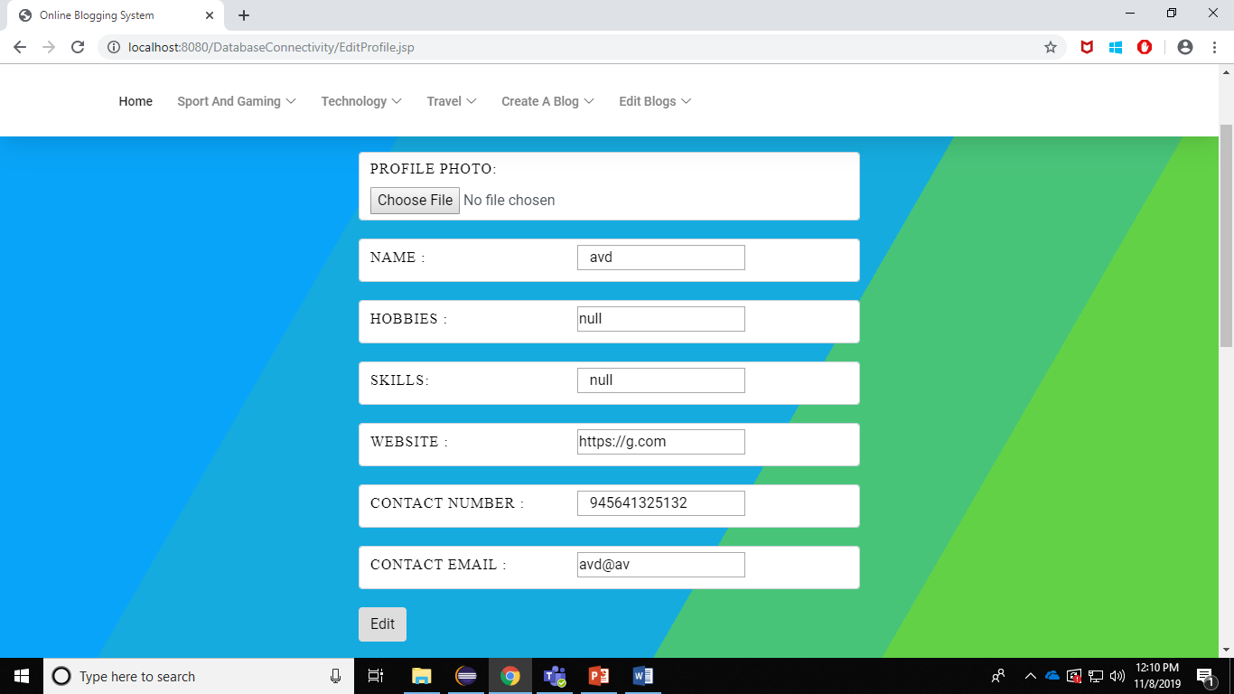
Profile Page Edit Profile

Slide 16
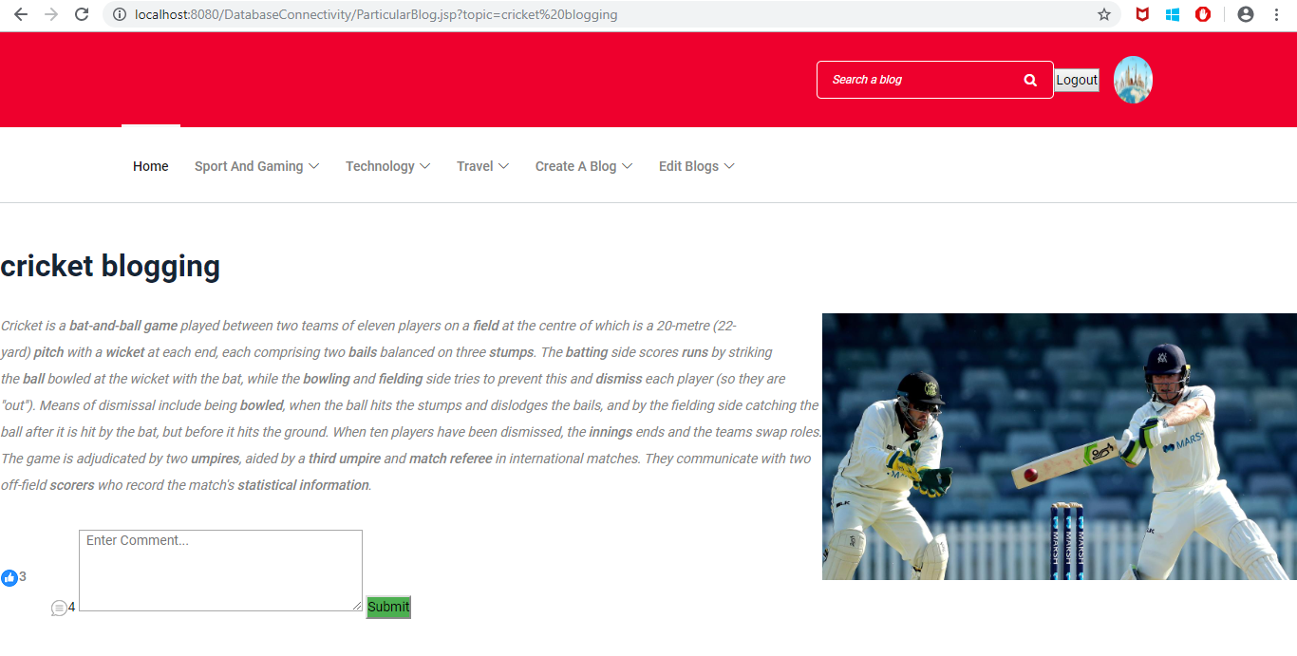
Blog Page- After login

Slide 17
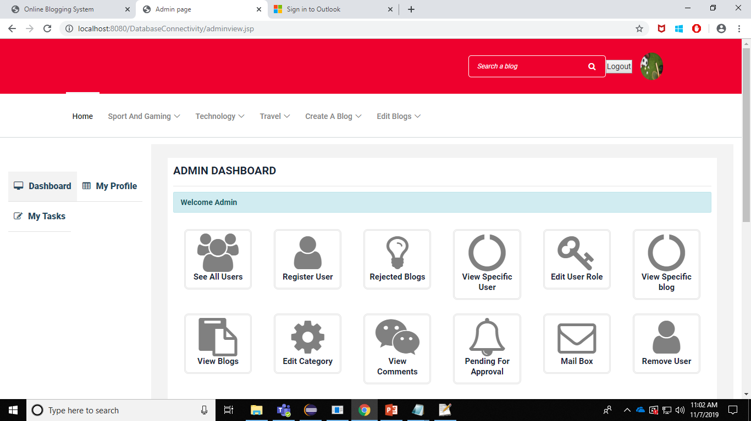
Admin Page
Once the admin is logged in, he will be able to view MyProfile, User Details, Rejected Blogs, View Specific User, Pending For Approval, Mailbox, etc. After the work is done, he can logout from the website.

Slide 18
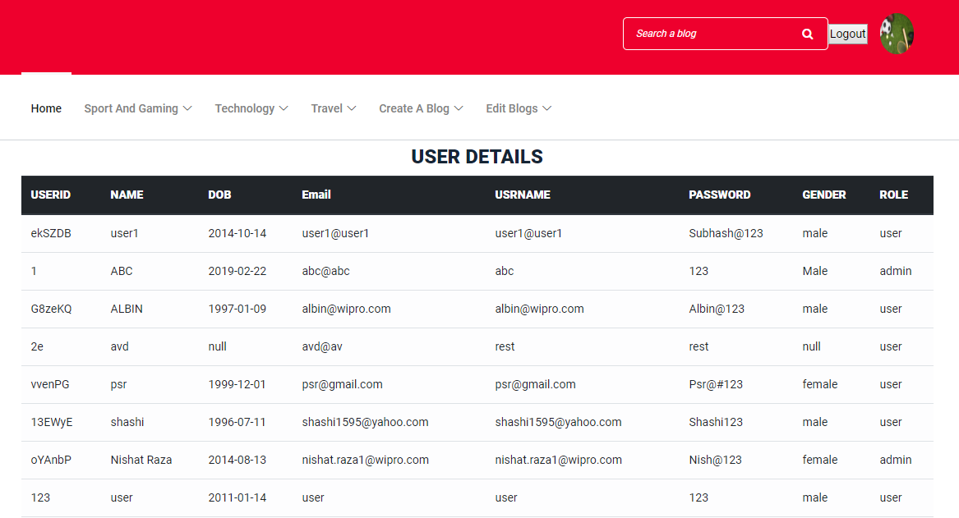
View All Users
The Admin is able to view all the user details like userid, name, dob, email, password etc…

Slide 19
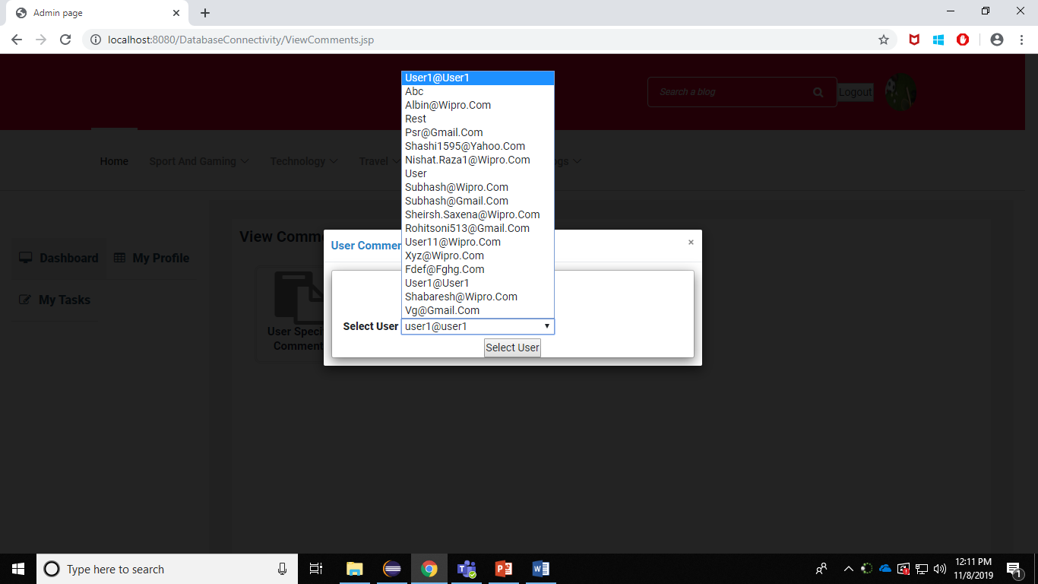
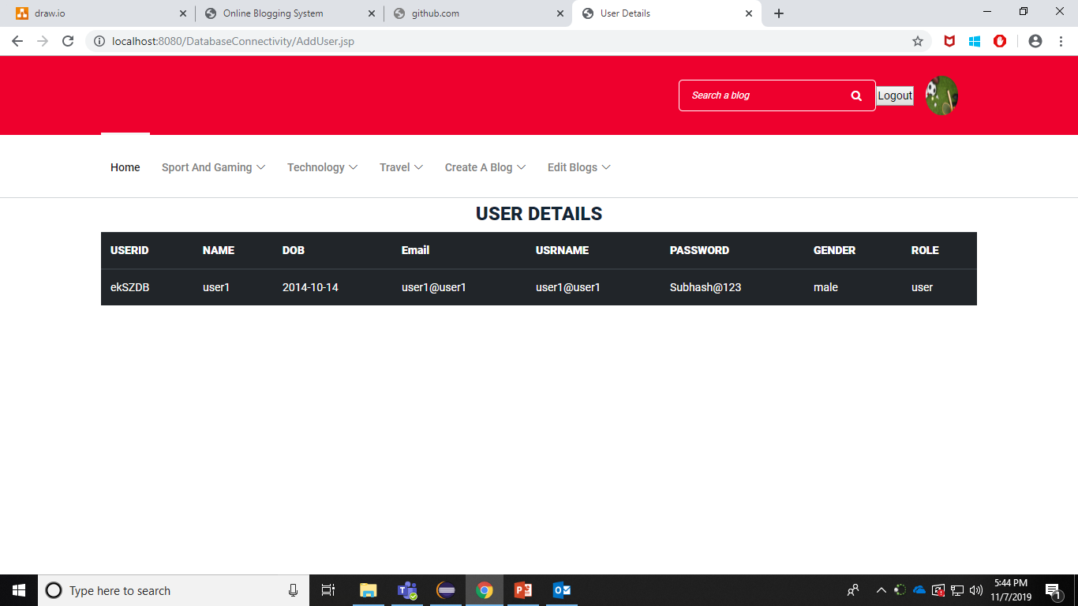
View Specific Users
The Admin is able to view the specific user details like userid, name, dob, email, password etc…

Slide 20
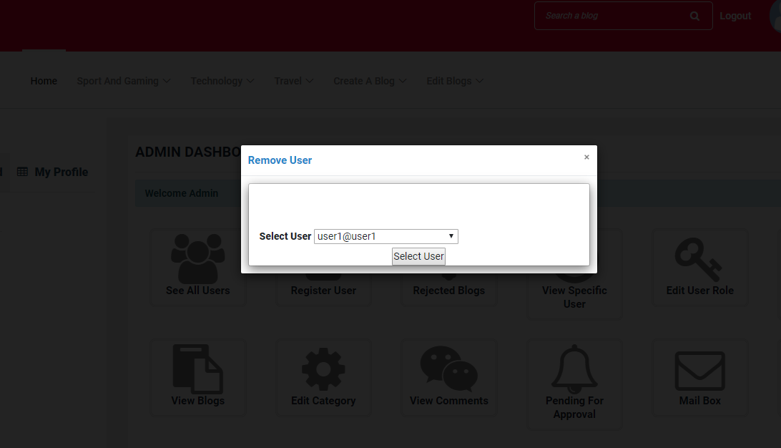
Remove User
The Admin is able to remove users from the database which removes all his blogs and comments.

Slide 21
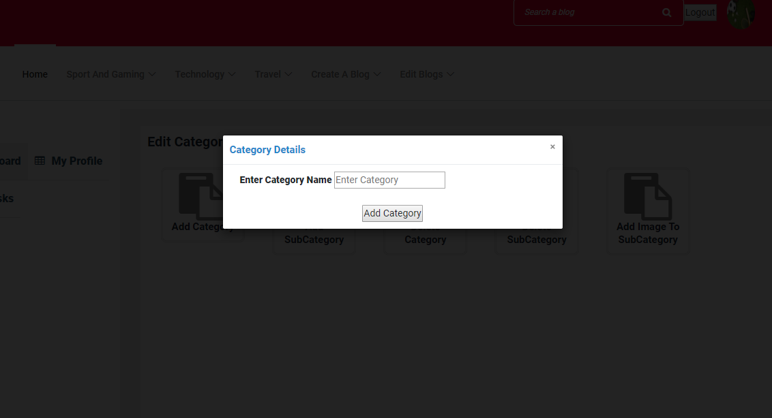
Add Category
The Admin is able to add new category using add new category option.

Slide 22
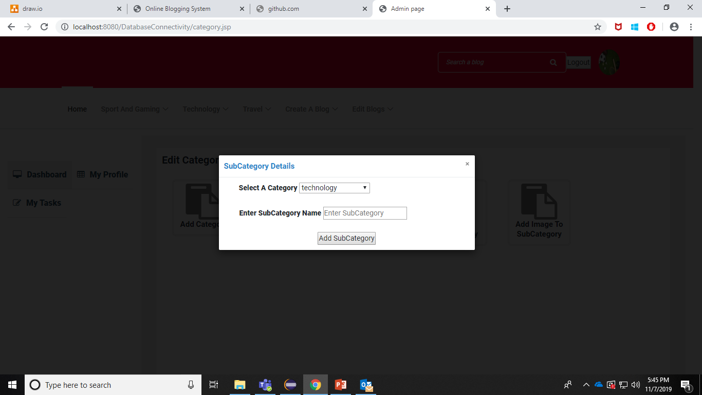
Add Sub-Category
The Admin is able to add new sub-category for existing categories using add new sub-category option.

Slide 23
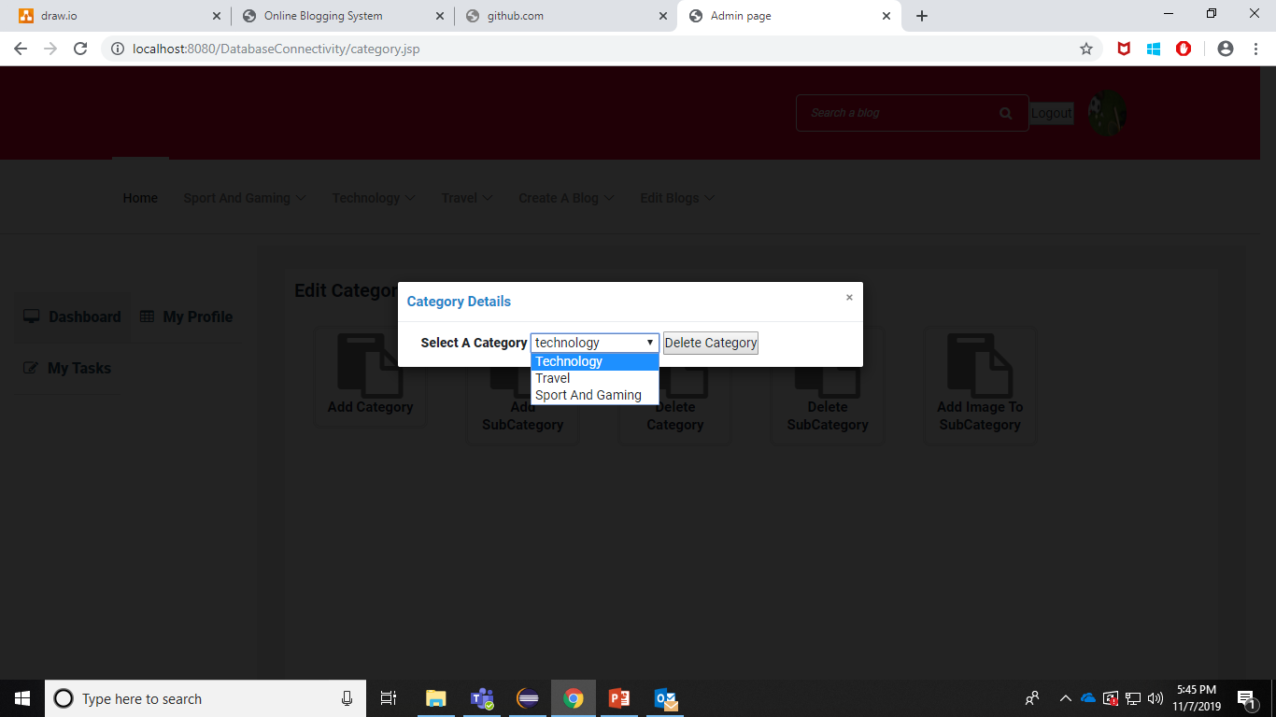
Delete Category
The Admin is able to delete category using delete category option. The sub-categories, blogs and comments are also deleted from the database.

Slide 24
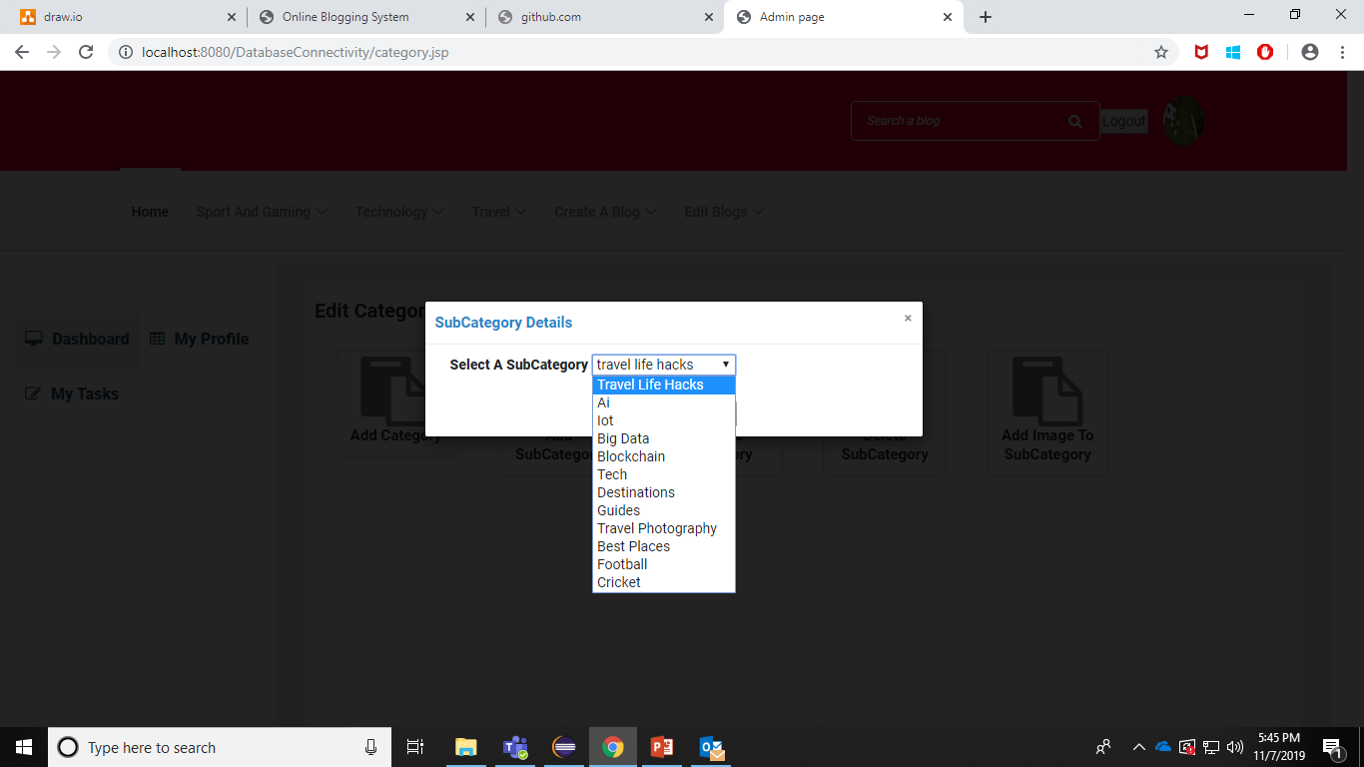
Delete Sub-Category
The Admin is able to delete sub-category using delete sub-category option. The blogs and comments are also deleted from the database.

Slide 25
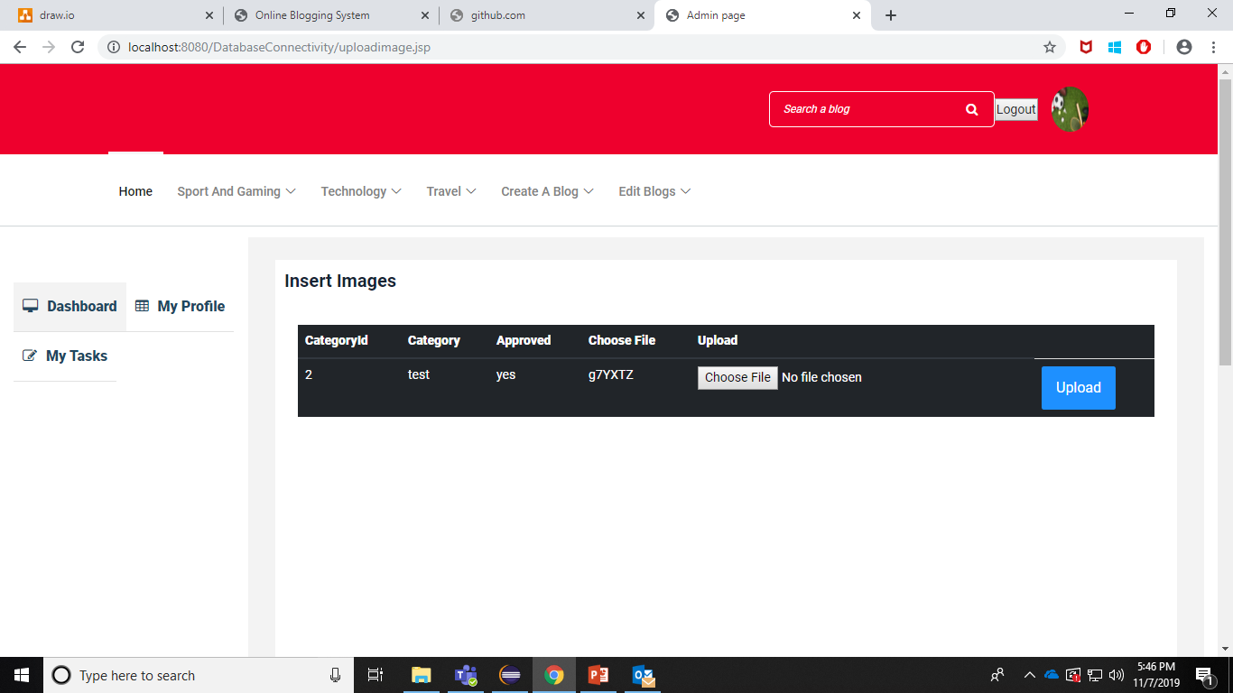
Add Image to Sub-Category
The Admin is able add image to specific sub-category.

Slide 26
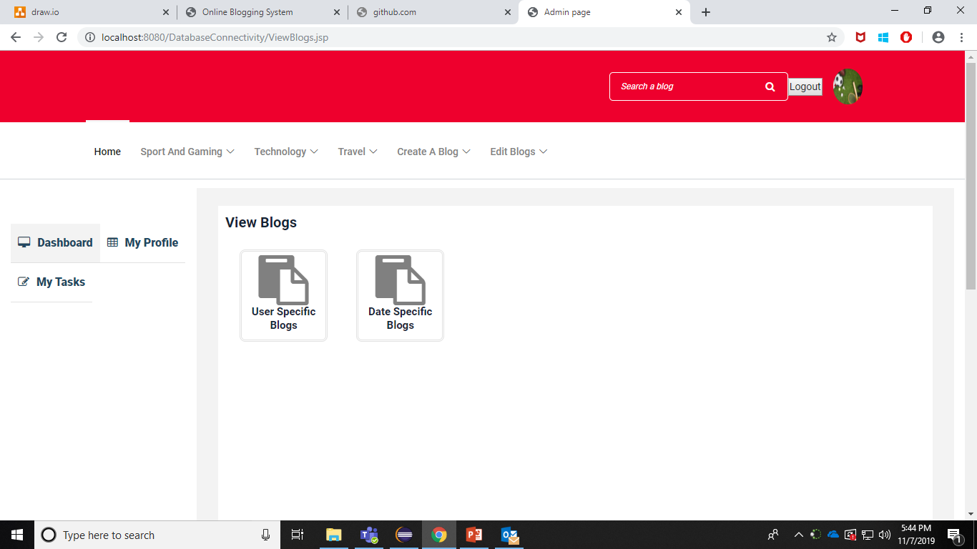
View Blogs
The admin is able to view user specific blogs and date specific blogs.

Slide 27
View Blogs-User Specific
The admin is able to view all the blogs which is written by that specific user.

Slide 28
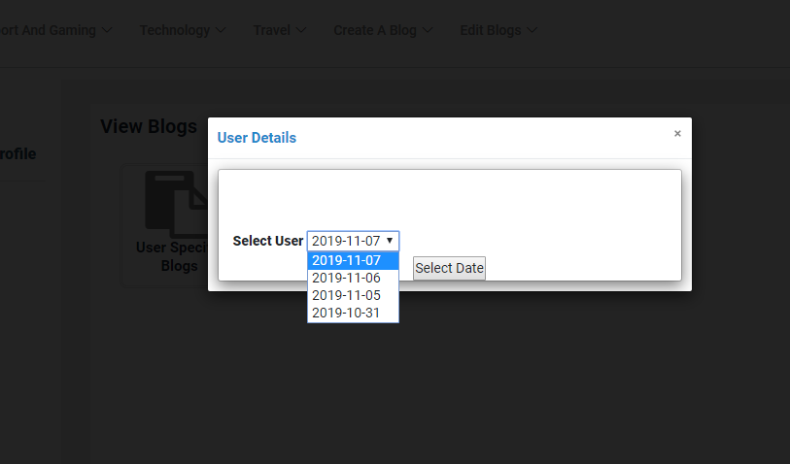
View Blogs-Date Specific
The admin is able to view all the blogs which is written in a specific date.

Slide 29
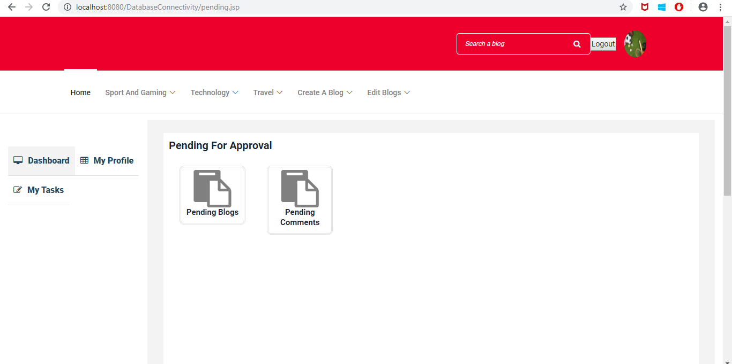
Pending For Approval

Slide 30
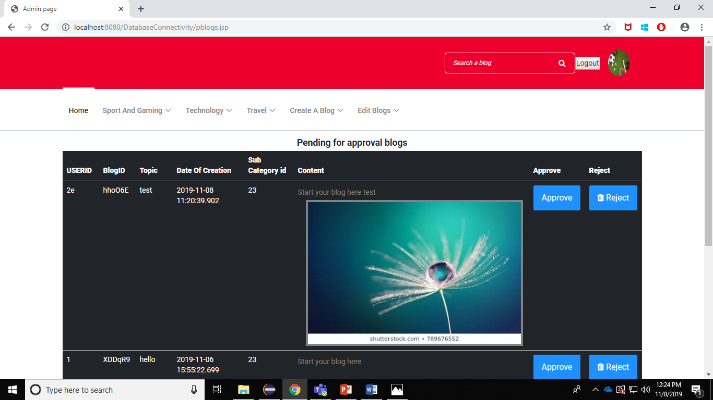
Pending Blogs

Slide 31
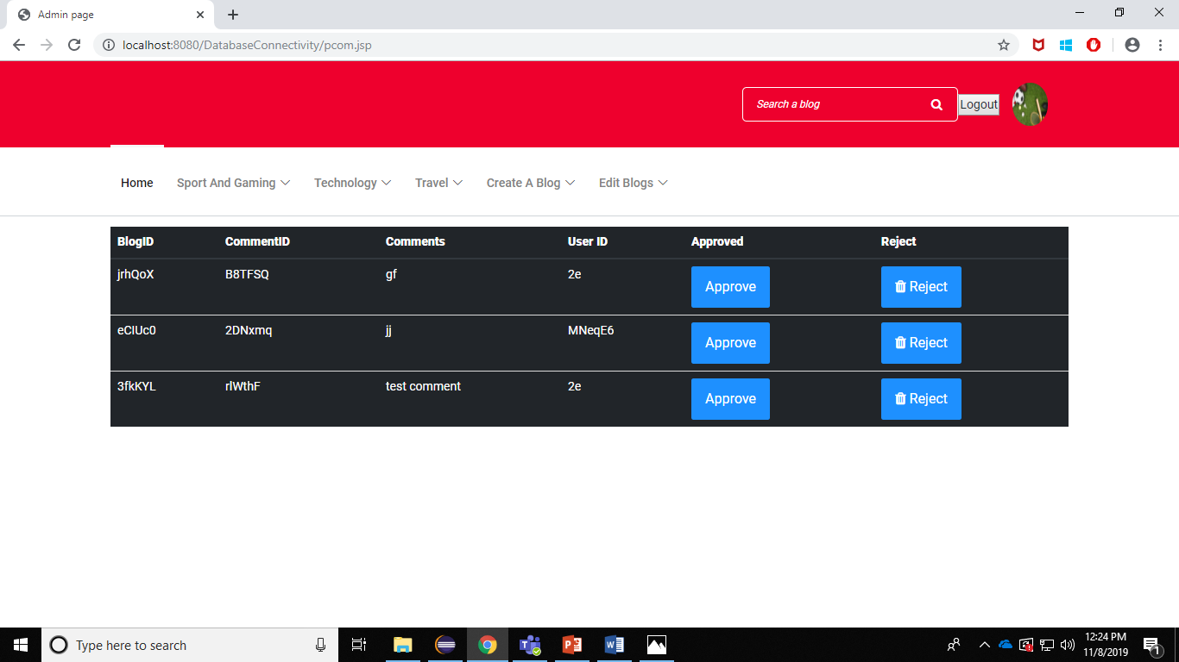
Pending Comments

Slide 32
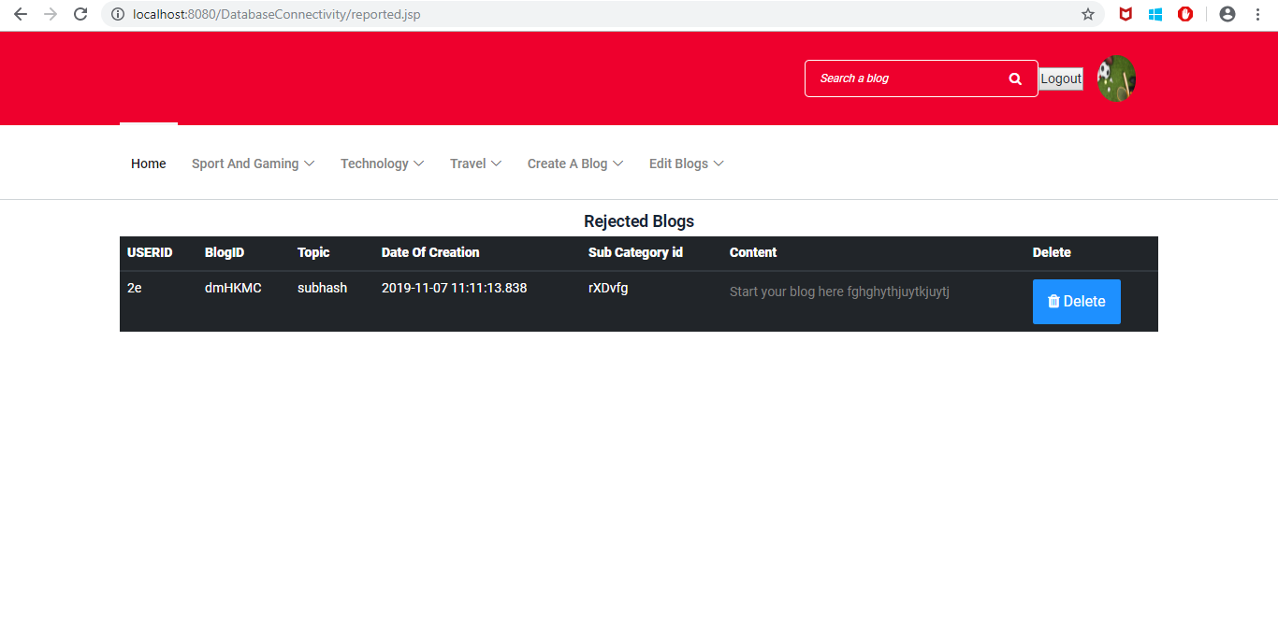
Rejected Blogs

Slide 33
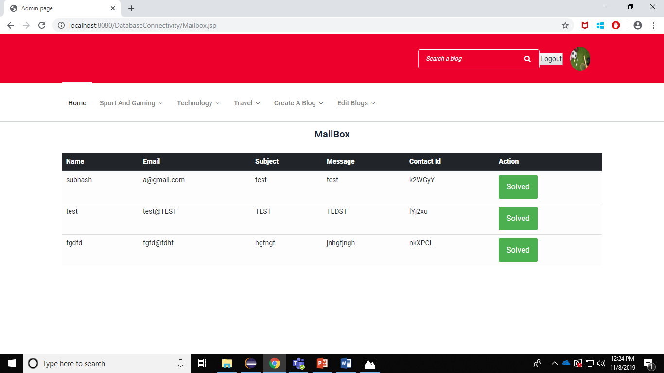
Mailbox/Contact Us

Slide 34
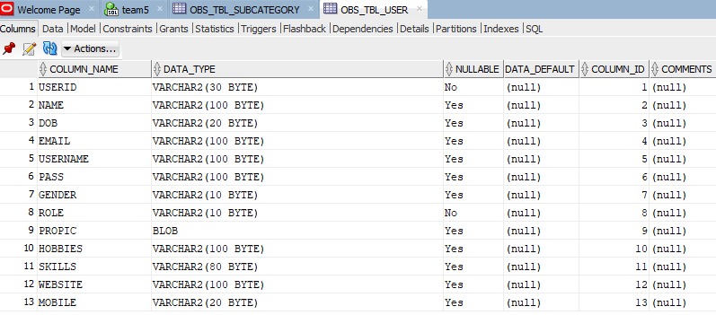
UserTable

Slide 35
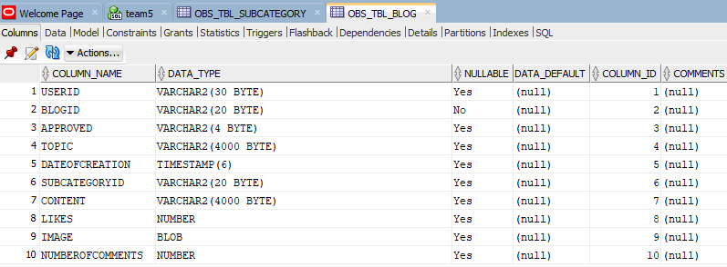
BlogTable

Slide 36
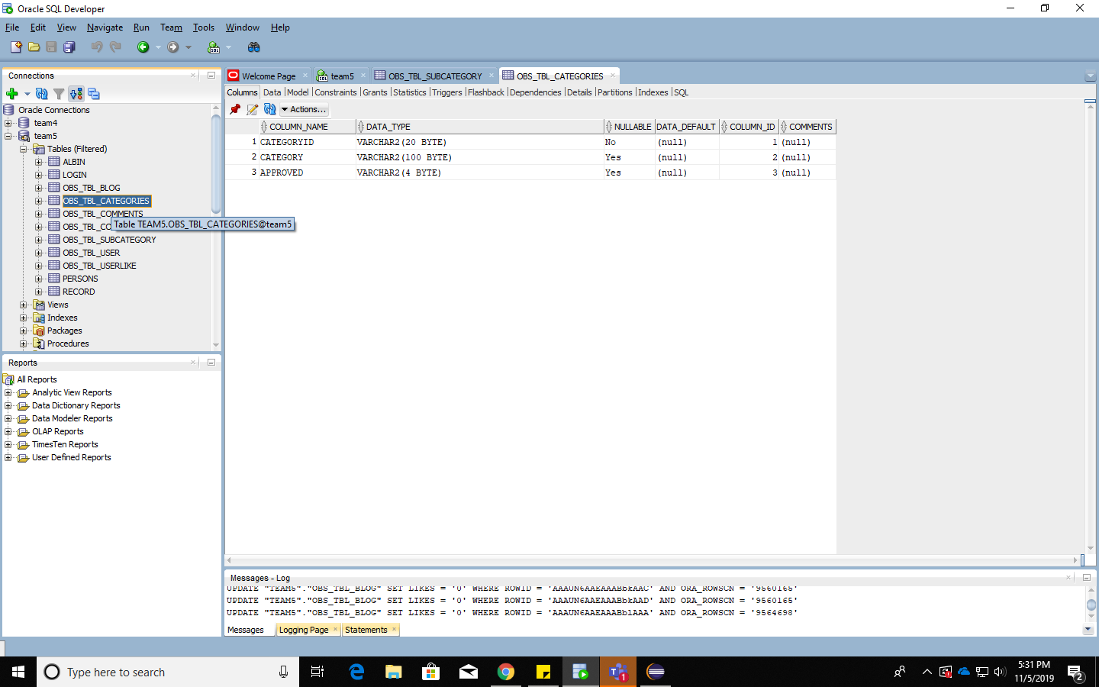
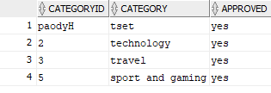
Category table

Slide 37
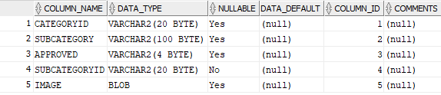
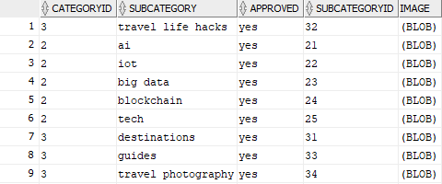
Subcategory table

Slide 38
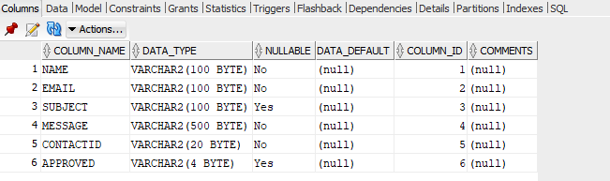
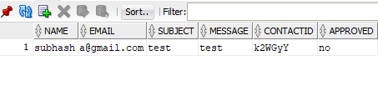
Contact table

Slide 39
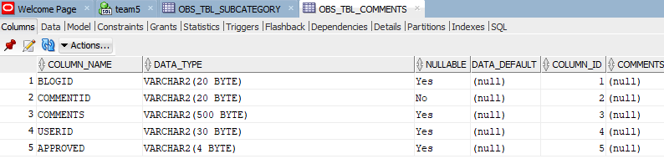
Comment table

Slide 40
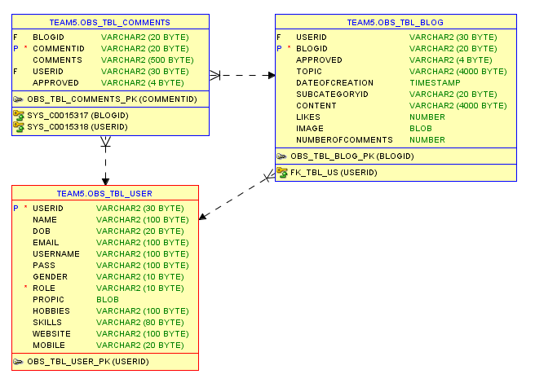

Slide 41
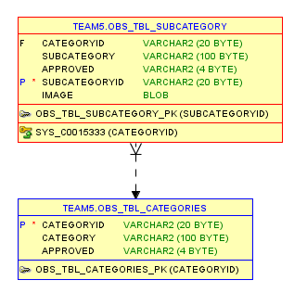

Slide 42
Thank You

